Slide 1
Sunbot Prototyping Presentation
Matt, Ben, Vaishu, Nakai

Slide 2
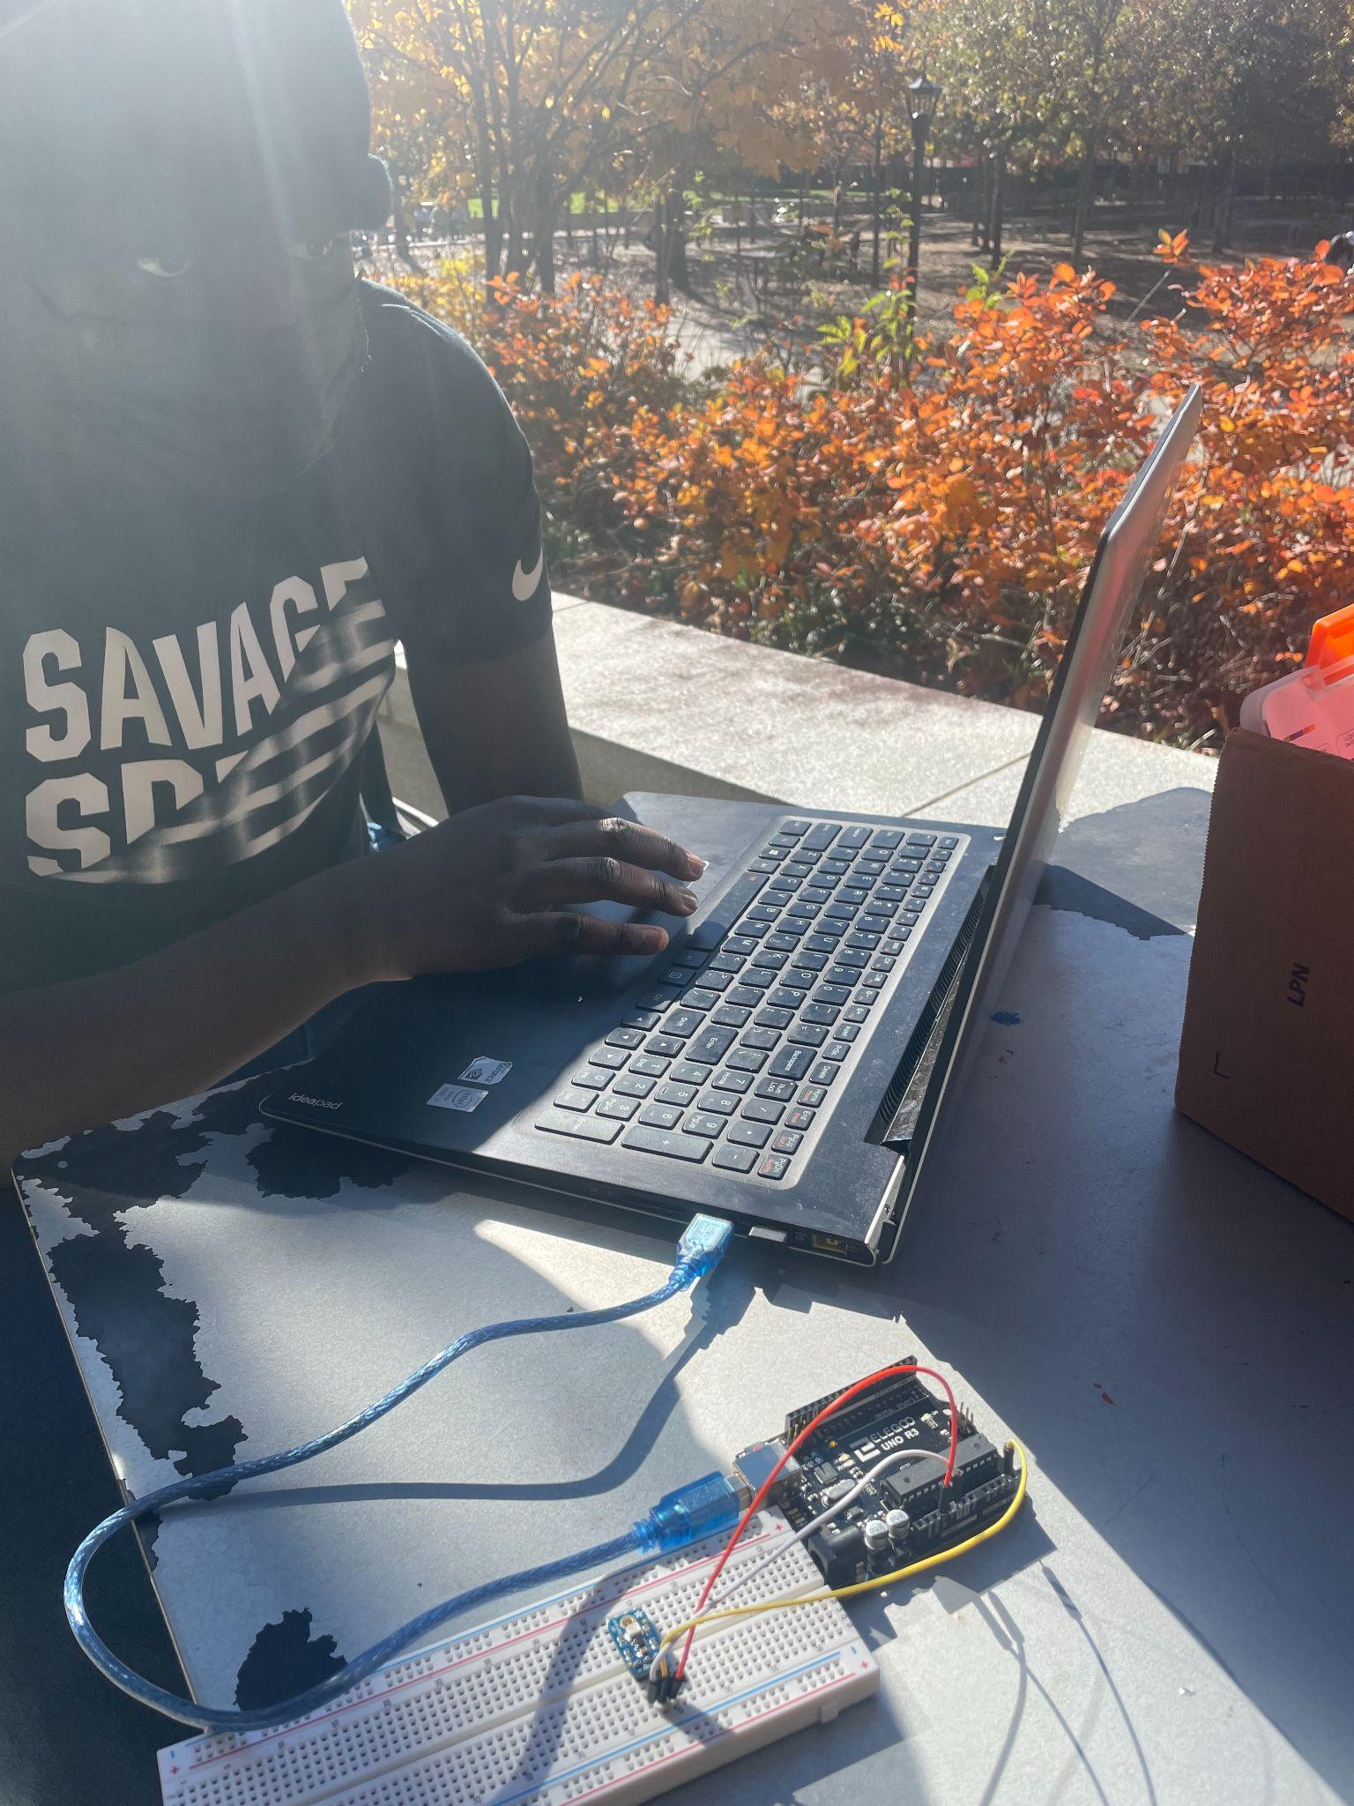
UV Sensing
We realized, it’s not that easy.
Calculations with nanowaves, voltage, and
location conditions determine UV, BUT

Slide 3
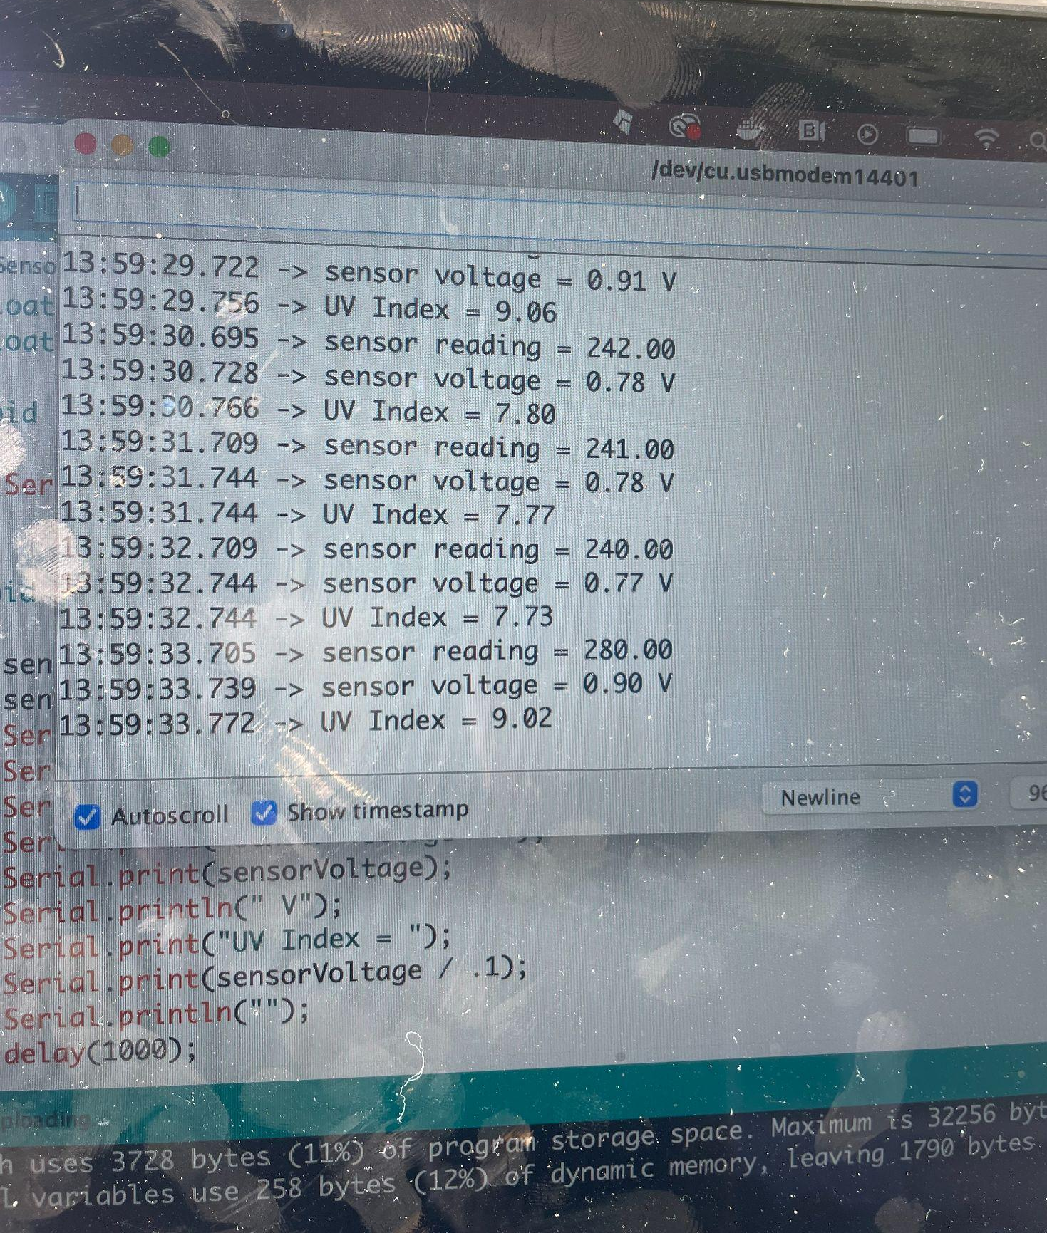
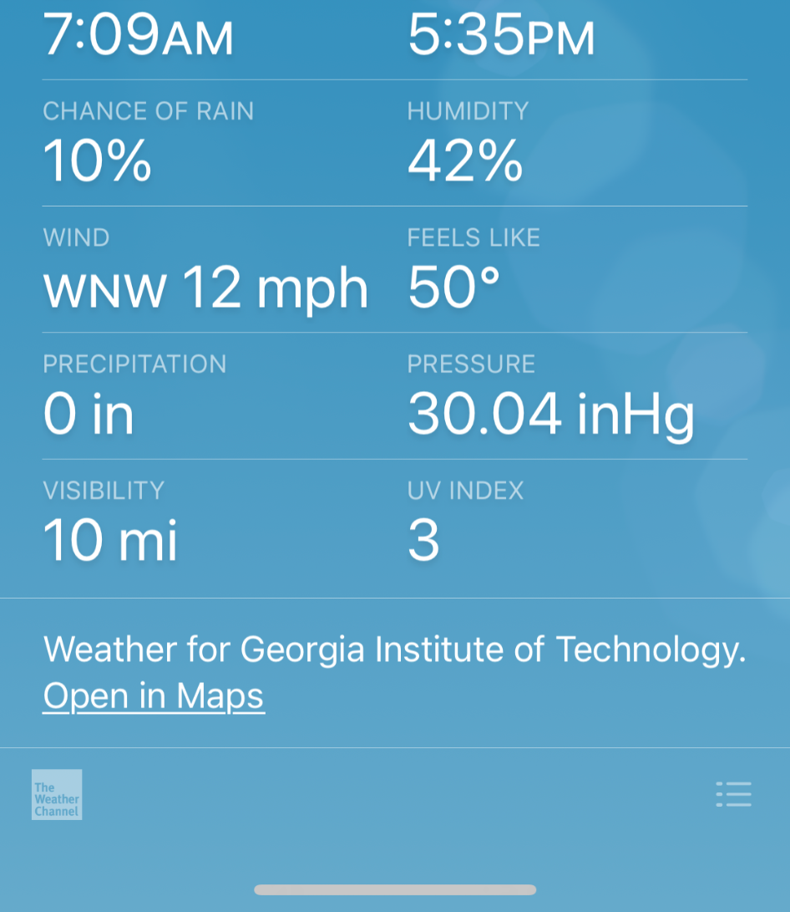
UV Sensing

Slide 4
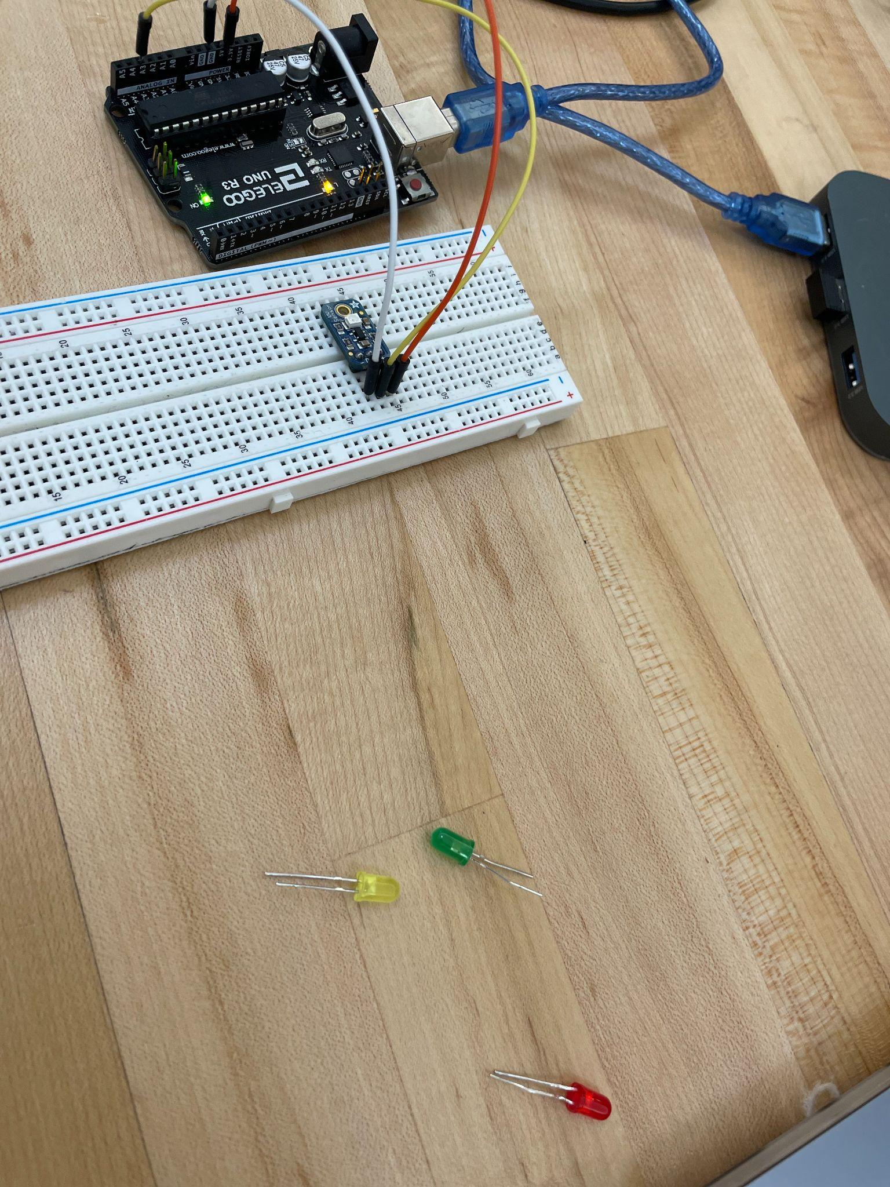
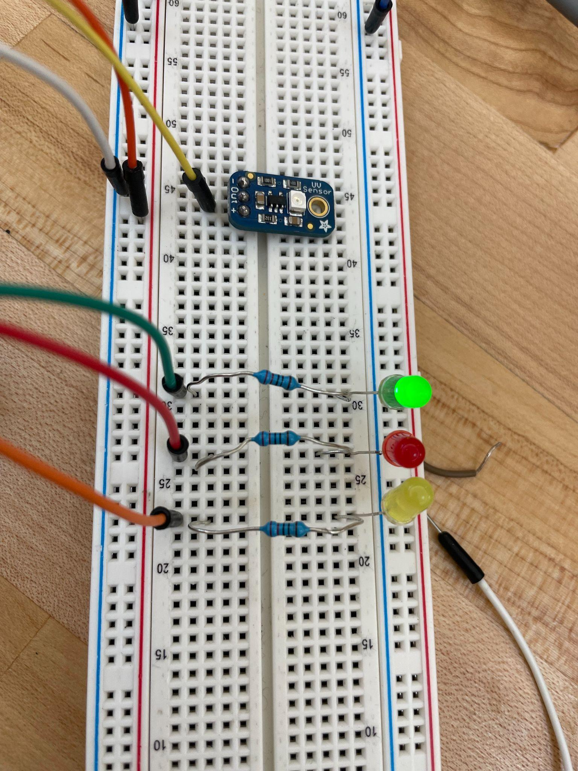
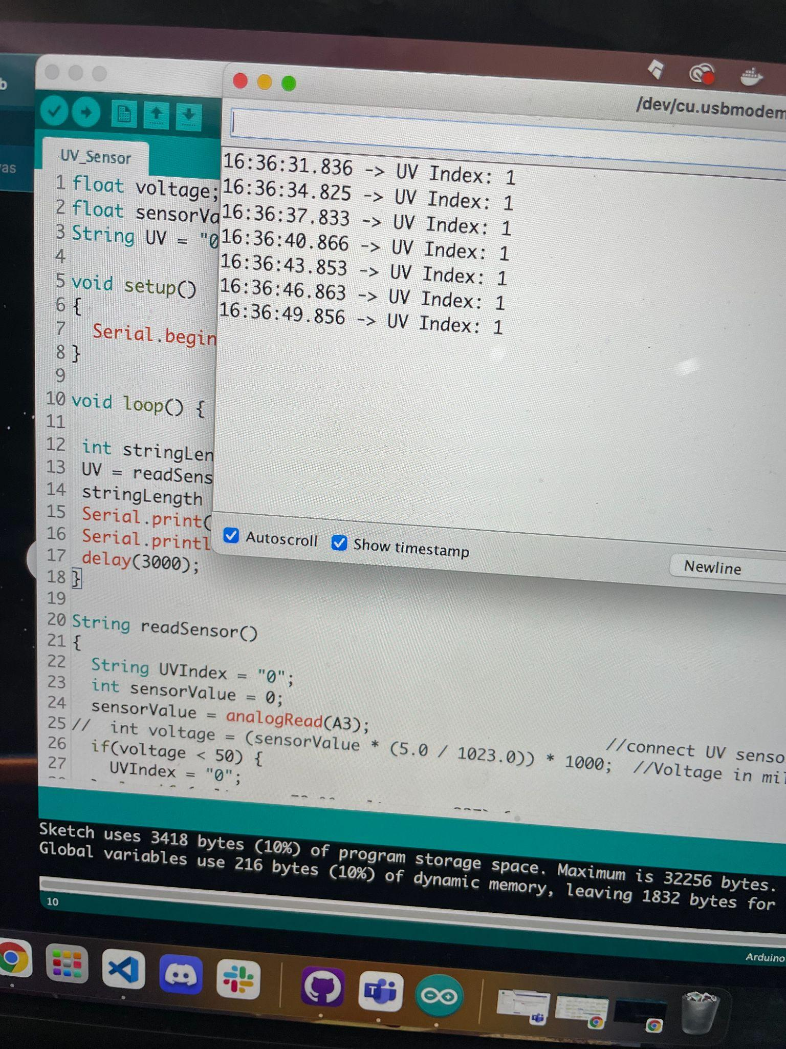
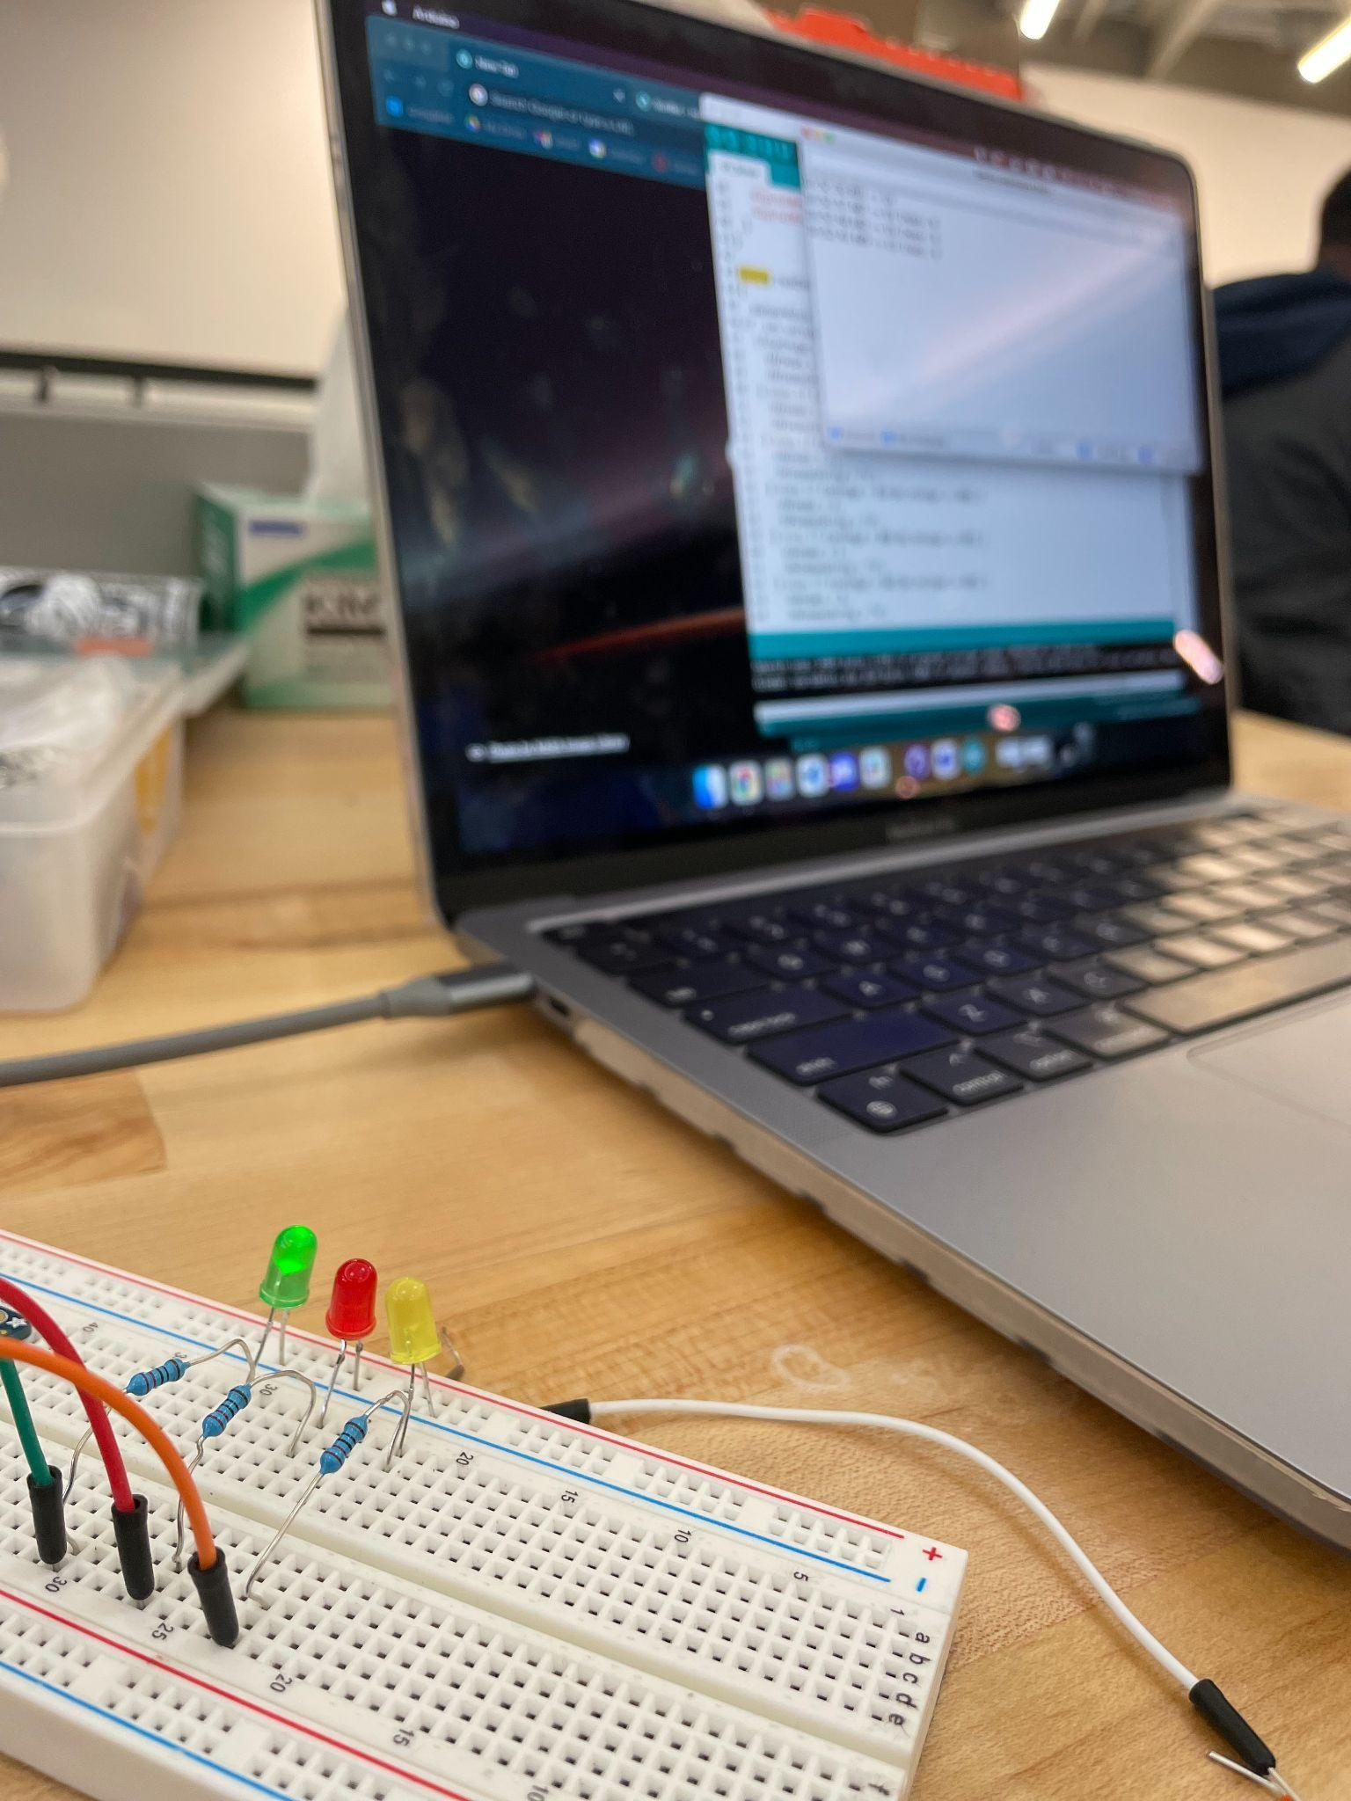
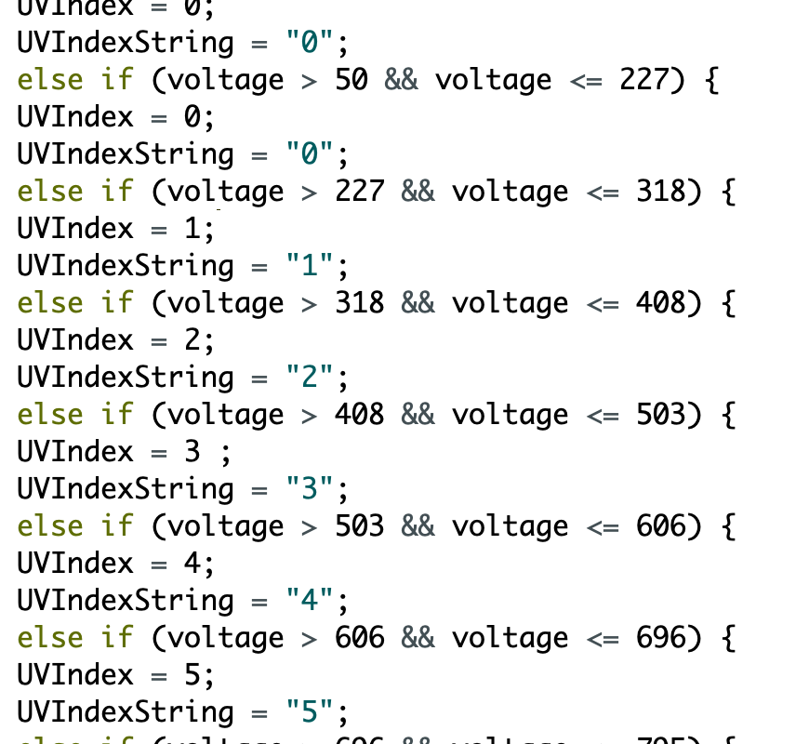

Slide 5
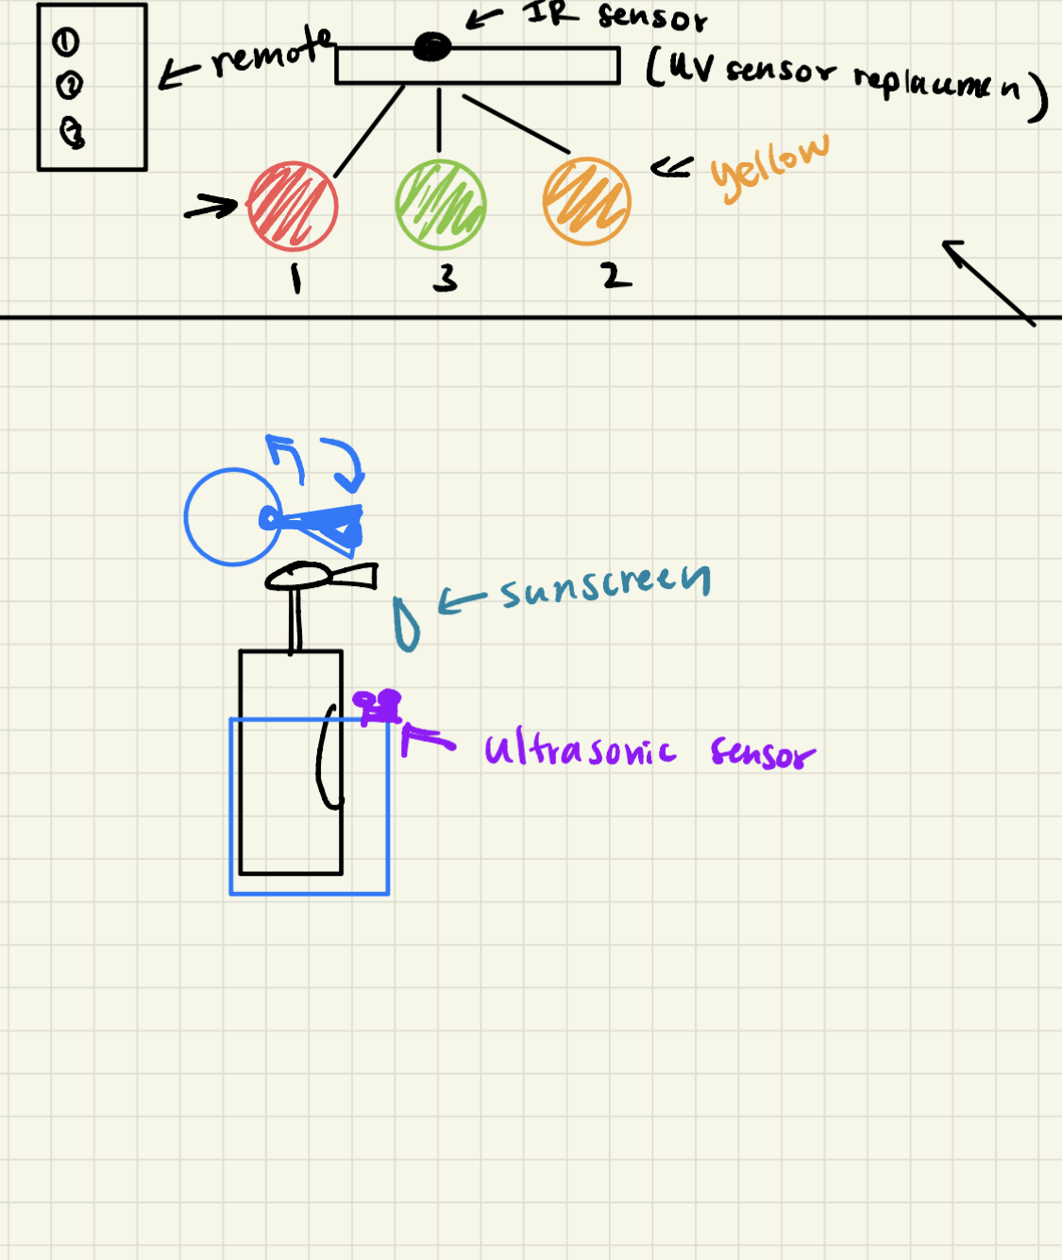
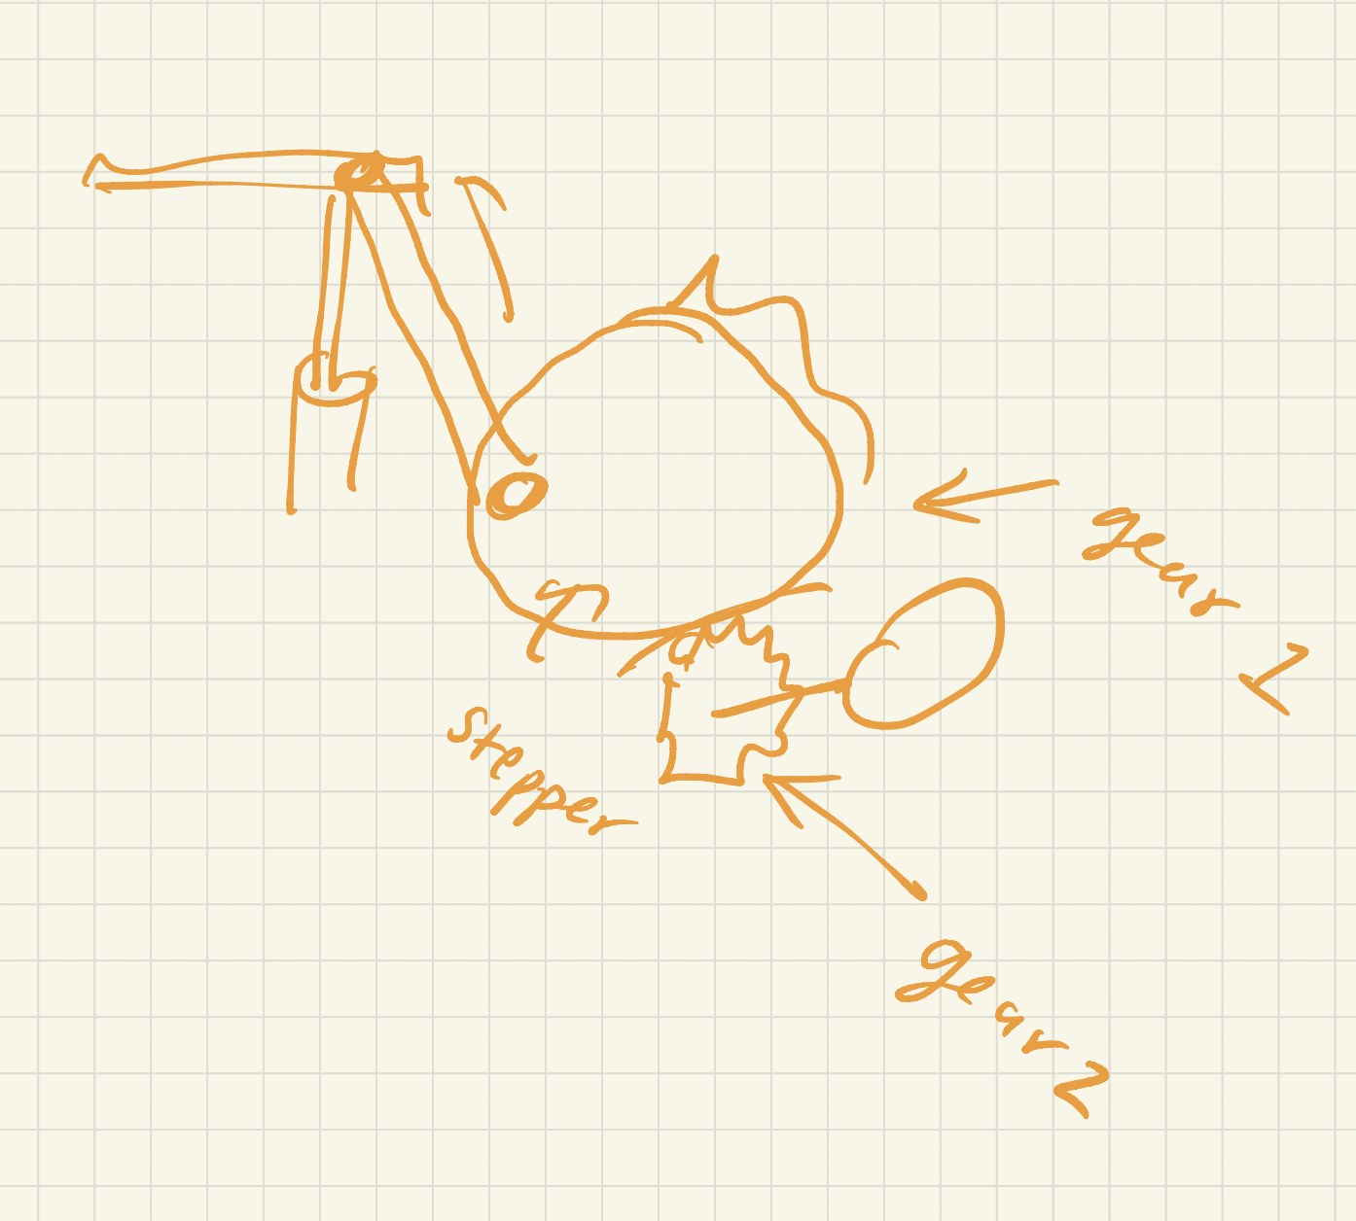
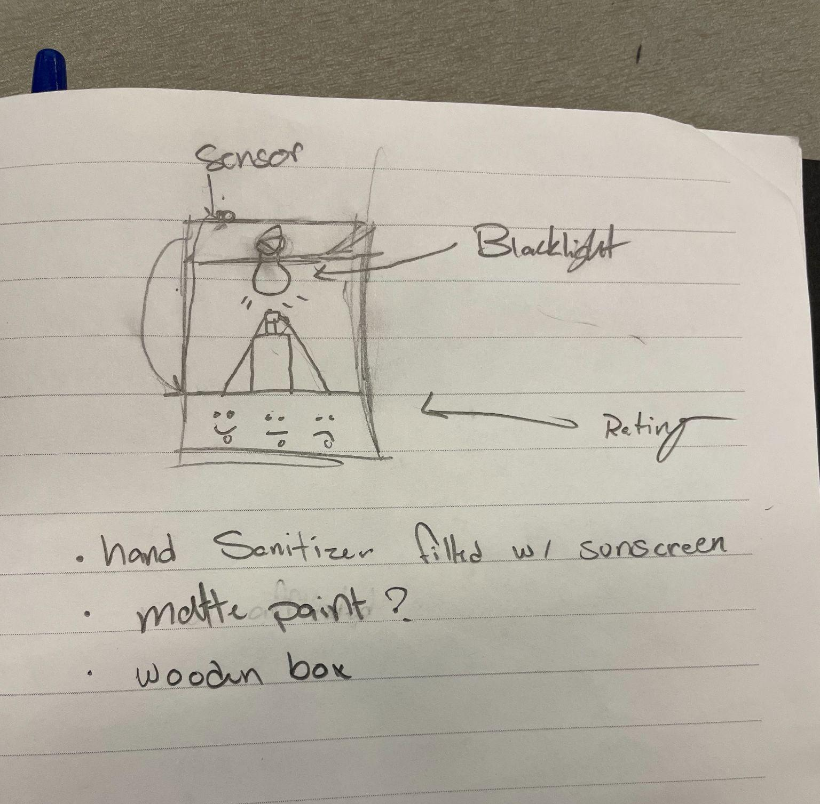
Initial motor sketches

Slide 6
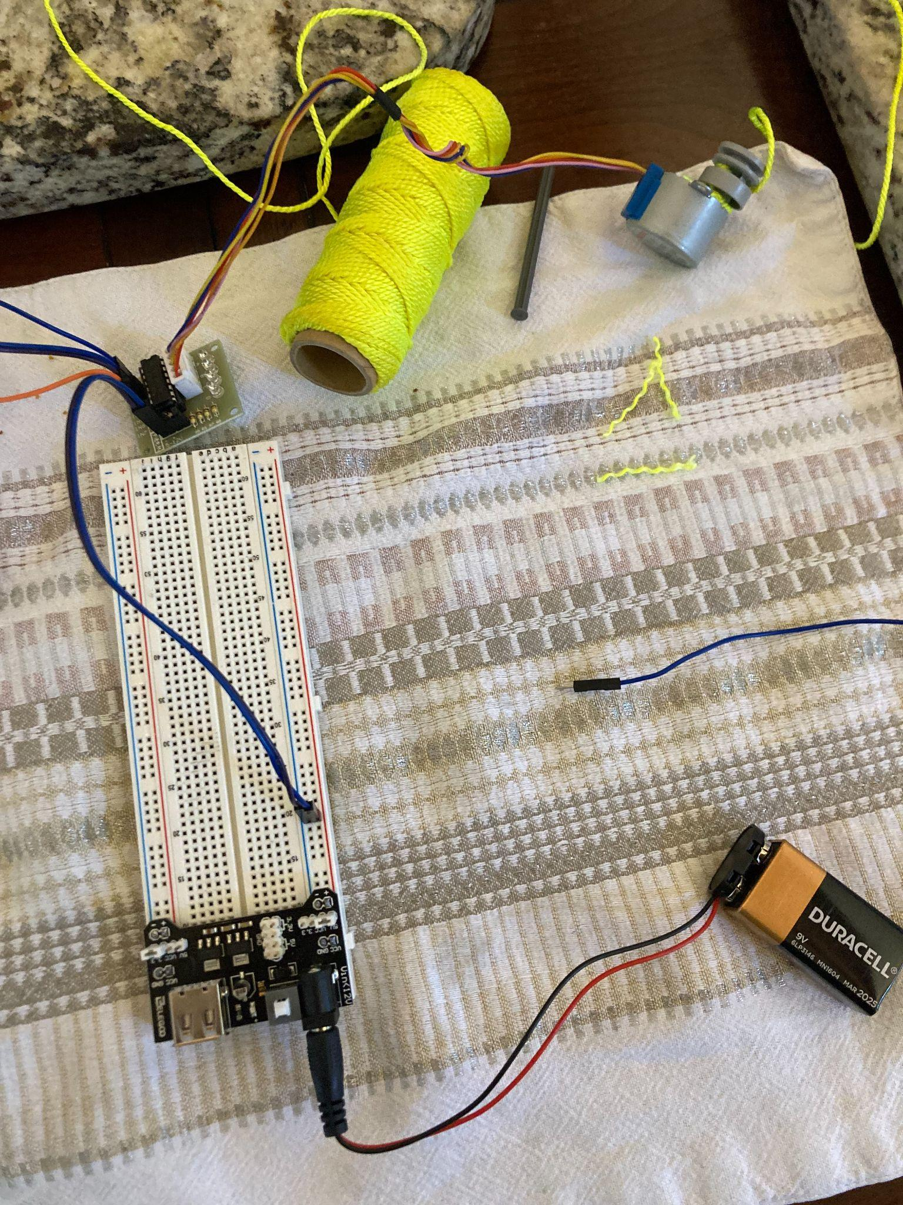
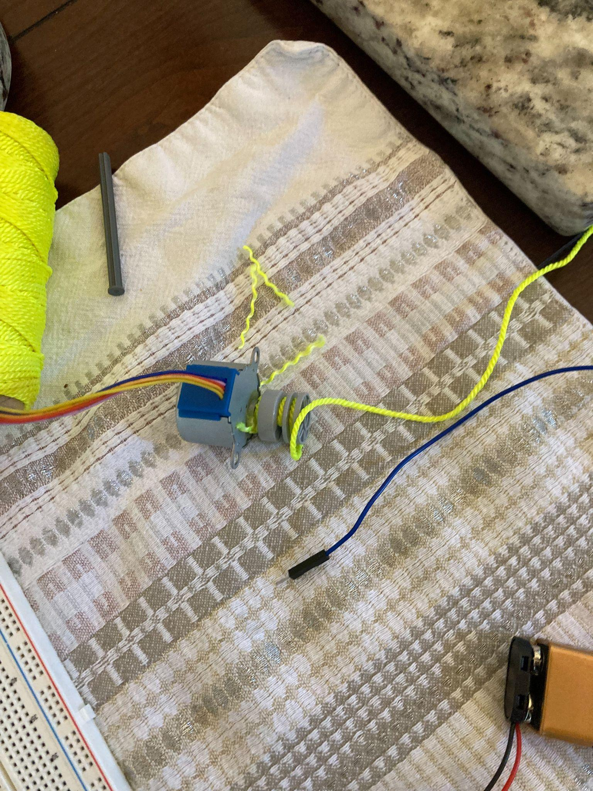
Motor Problems
Spring/ Push down bottles are ALSO harder than it seems.
Our pulley systems with motors are not strong enough to pump the bottle
Solution: water pump?

Slide 7
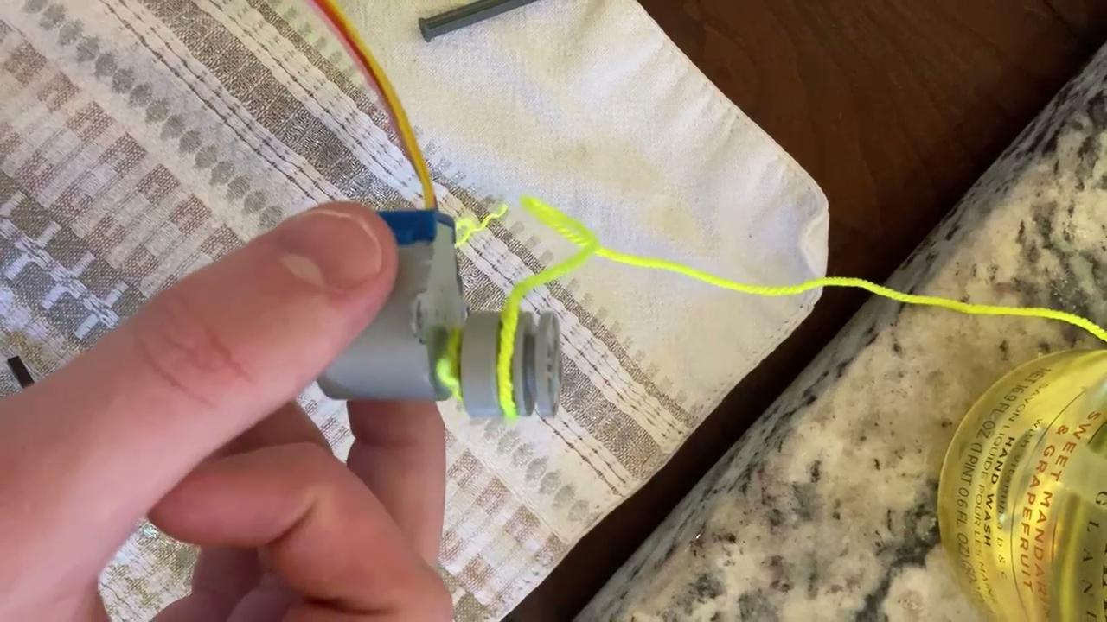

Slide 8
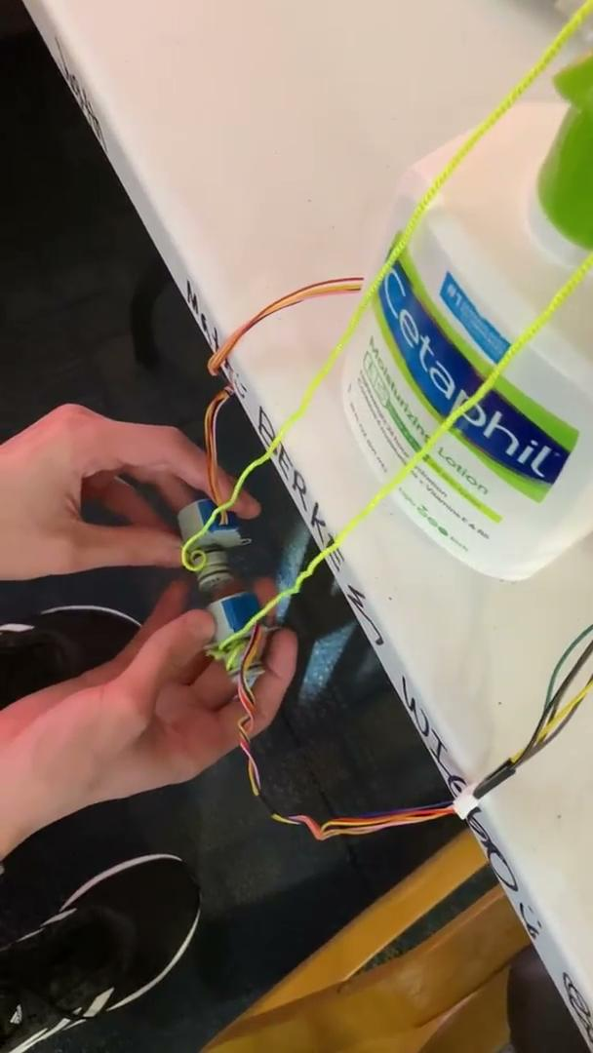

Slide 9
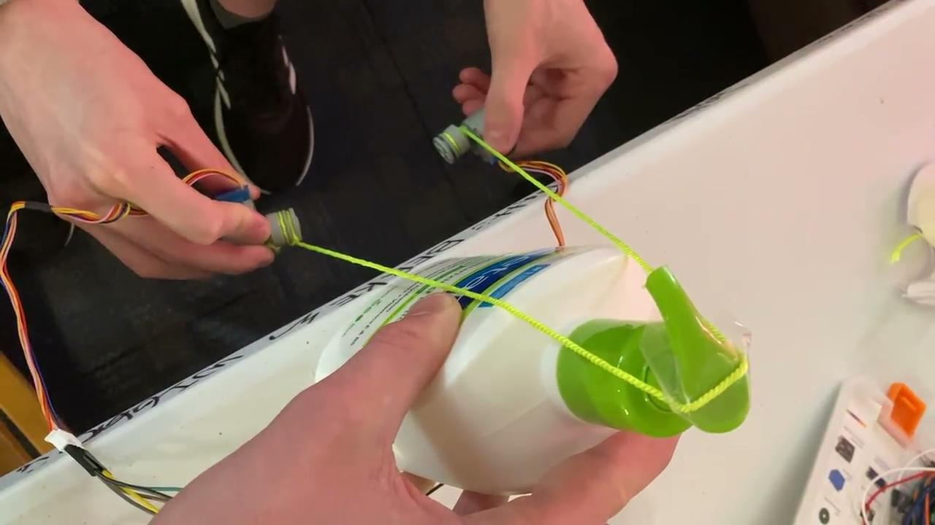

Slide 10
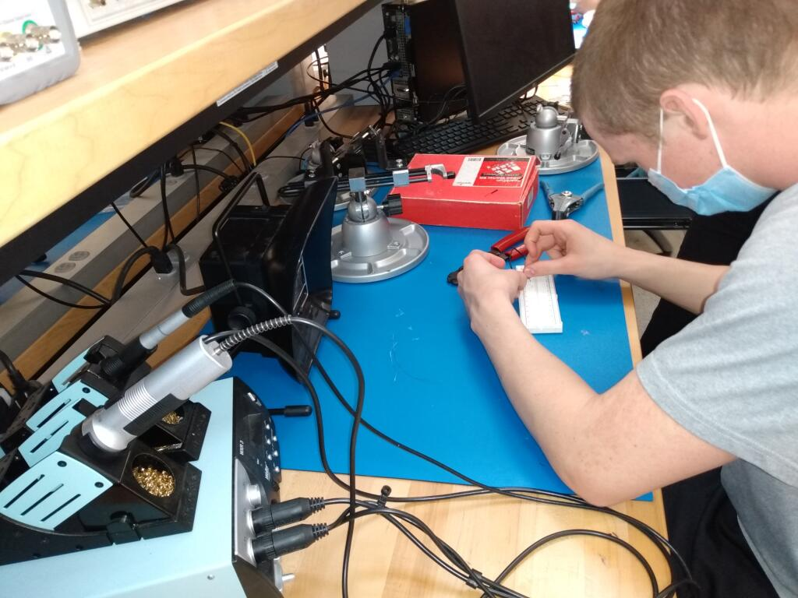
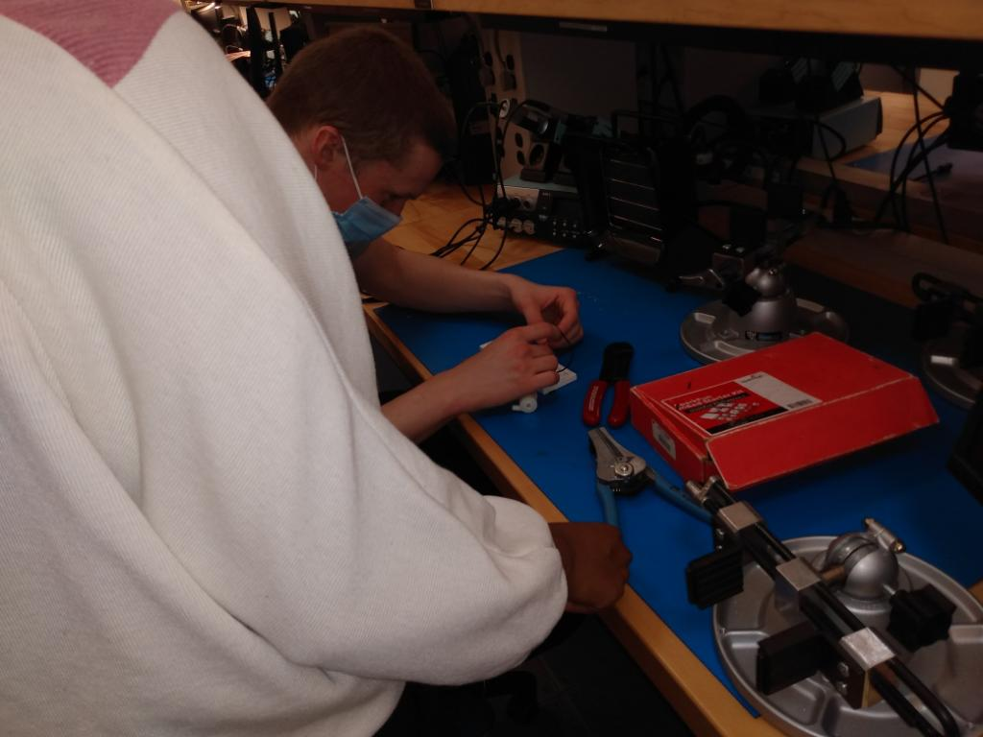
THANK YOU CLARA
Soldering the water pump- we have two models of pumps, but we are initially starting with Clara’s mini water pump

Slide 11
What we still need to do
Build the UV index LED ‘face’ instead of LEDs
See if motor pump works
Test sunscreen dispensing
Using ultrasonic sensor

